Slide 1
SUPPLY CHAIN ANALYSIS
A Power BI Dashboard Project — Data-Driven Insights across Inventory, Logistics, Suppliers & Profitability
Presented by: Abhiyuday Sharma 12508368
Bhaveen Kumar Tak 12506979
📊
Mittal School of Business, Lovely Professional University

Slide 2
Agenda
What this presentation covers
1
Introduction & Business Problem
7
Inventory & Supplier Analysis
2
Project Objectives
8
Logistics & Profitability Analysis
3
About the Dataset
9
Business Insights & Recommendations
4
Tools & Methodology
10
Consolidated Key Findings
5
Dashboard Architecture
11
Strategic Recommendations
6
Executive Overview Dashboard
12
Challenges, Conclusion & Future Scope
Supply Chain Analysis — Power BI Project
2

Slide 3
Introduction & Business Problem
Modern supply chains generate large volumes of data across procurement, production, inventory, logistics and sales — but this data is often scattered across spreadsheets and systems, making it hard to see the full picture.
This project consolidates a real-world style supply chain dataset into an interactive Power BI dashboard, allowing decision-makers to monitor performance and identify improvement areas at a glance.
The core business problem: how can a company track product performance, supplier reliability, logistics cost and profitability together, in one place, to make faster and better-informed decisions?
📦
Fragmented Data
Inventory, supplier and logistics data tracked in silos
⏱
Delayed Insight
Manual reporting slows down decision-making
📉
Hidden Inefficiencies
Costly suppliers or transport modes go unnoticed
Supply Chain Analysis — Power BI Project
3

Slide 4
Project Objectives
🎯
📈
🏭
Consolidate Data
Track Performance
Evaluate Suppliers
Bring product, supplier, inventory and logistics data into a single unified model.
Monitor revenue, sales volume and profitability across product categories.
Compare suppliers on production volume, defect rate and lead time.
🚚
✅
💡
Optimise Logistics
Improve Quality
Enable Decisions
Identify the most cost-efficient transportation modes and routes.
Highlight defect and inspection patterns to strengthen quality control.
Turn analysis into clear, actionable business recommendations.
Supply Chain Analysis — Power BI Project
4

Slide 5
About the Dataset
100
27
3
5
4
Records (SKUs)
Attributes per record
Product Categories
Suppliers Tracked
Transportation Modes
Key Fields Captured
Dataset Snapshot
Product: Product type, SKU, Price, Availability, Revenue generated
✓ Product Types: skincare, haircare, cosmetics
Supplier & Production: Supplier name, Location, Production volume, Manufacturing cost/lead time
✓ Suppliers: Supplier 1 – Supplier 5
Inventory & Quality: Stock levels, Order quantities, Inspection results, Defect rates
✓ Transport Modes: Road, Rail, Air, Sea
✓ Inspection Results: Pass, Fail, Pending
Logistics: Shipping times/costs/carriers, Transportation mode, Routes
✓ Derived fields added: Profit Margin, Revenue Category, Shipping Efficiency
Supply Chain Analysis — Power BI Project
5

Slide 6
Tools & Methodology
1
2
3
4
5
Raw Data (CSV)
Power Query
Data Modeling
DAX Measures
Power BI Visuals
Sourced supply chain dataset with 100 SKU-level records
Cleaned, renamed and validated columns; handled data types
Structured fields into product, supplier and logistics dimensions
Built KPIs — Profit Margin, Revenue Category, Shipping Efficiency
Designed a 4-page interactive dashboard with slicers
Tools Used:
Microsoft Power BI Desktop • Power Query Editor • DAX (Data Analysis Expressions) • Excel/CSV data source
Data Cleaning Steps: removed inconsistent entries, standardised column names, verified numeric ranges for costs/rates, and engineered new calculated columns (Profit Margin, Revenue Category, Shipping Efficiency) to support deeper analysis.
Supply Chain Analysis — Power BI Project
6

Slide 7
Dashboard Architecture
A 4-page interactive Power BI report
Page 1
Page 2
Page 3
Page 4
📊
📦
🚚
💡
Executive Overview
Inventory & Supplier Analysis
Logistics & Profitability
Business Insights & Recommendations
Company-wide KPIs: revenue, units sold, shipping cost, defect rate
Stock levels, production volumes, defect and inspection breakdowns
Shipping cost/time by mode, profit margin, supplier lead times
Consolidated takeaways and action items for each area
Interactivity: every page shares synchronized slicers — Product Type, Supplier Name, Transportation Mode and Inspection Result — letting users filter the entire report from any page.
Supply Chain Analysis — Power BI Project
7

Slide 8
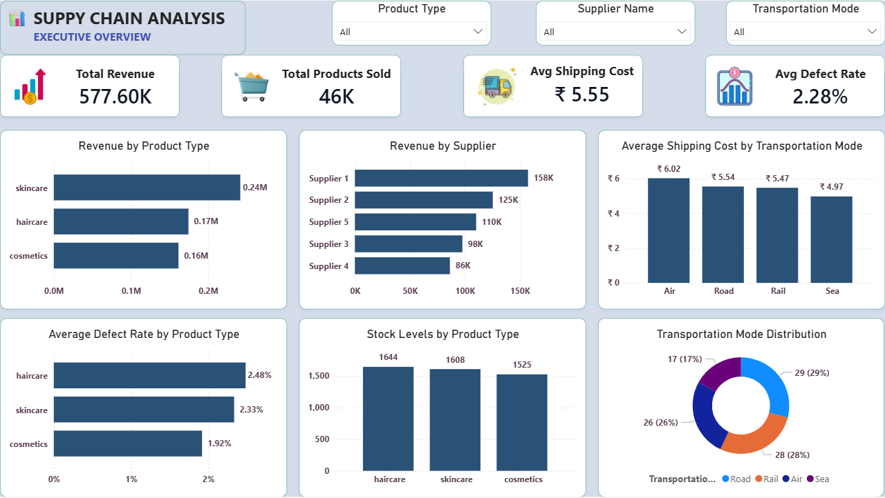
DASHBOARD PAGE 1
Executive Overview
Live Power BI dashboard — company-wide performance snapshot
8

Slide 9
Executive Overview — KPIs & Insights
₹577.60K
46K
₹5.55
2.28%
Total Revenue
Total Products Sold
Avg. Shipping Cost
Avg. Defect Rate
Revenue by Product Type
Key Insights
Skincare is the top-performing category, generating ₹0.24M — nearly 42% of total revenue.
Air transport has the highest average shipping cost (₹6.02) versus Sea, the cheapest (₹4.97).
Haircare products show the highest average defect rate (2.48%), warranting quality review.
The business sold 46K units across all categories with only a 2.28% average defect rate overall.
Supply Chain Analysis — Power BI Project
9

Slide 10
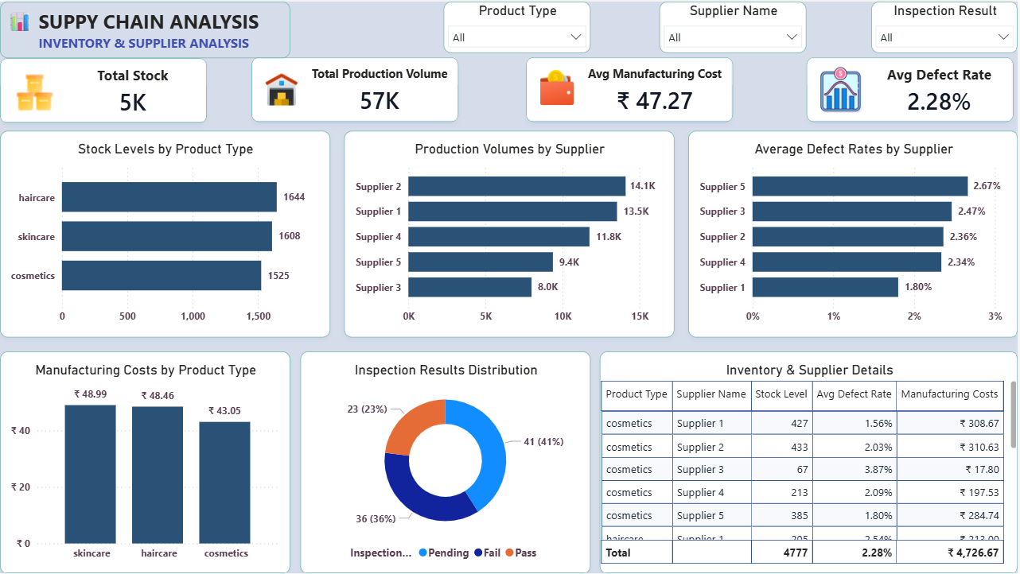
DASHBOARD PAGE 2
Inventory & Supplier Analysis
Live Power BI dashboard — stock, production and supplier quality
10

Slide 11
Inventory & Supplier — Key Insights
Production Volume by Supplier
Key Insights
Supplier 2 leads production volume (14.1K units), followed closely by Supplier 1 (13.5K).
Supplier 5 has the highest defect rate (2.67%) despite moderate output — a quality risk.
Supplier 1 combines strong output with the lowest defect rate (1.80%) — the most reliable partner.
Average Defect Rate by Supplier
Haircare holds the highest stock level (1,644 units), needing careful inventory planning.
Skincare carries the highest manufacturing cost per unit (₹48.99), impacting margins.
Total inventory stands at 4,777 units across 57K units of total production volume.
Supply Chain Analysis — Power BI Project
11

Slide 12
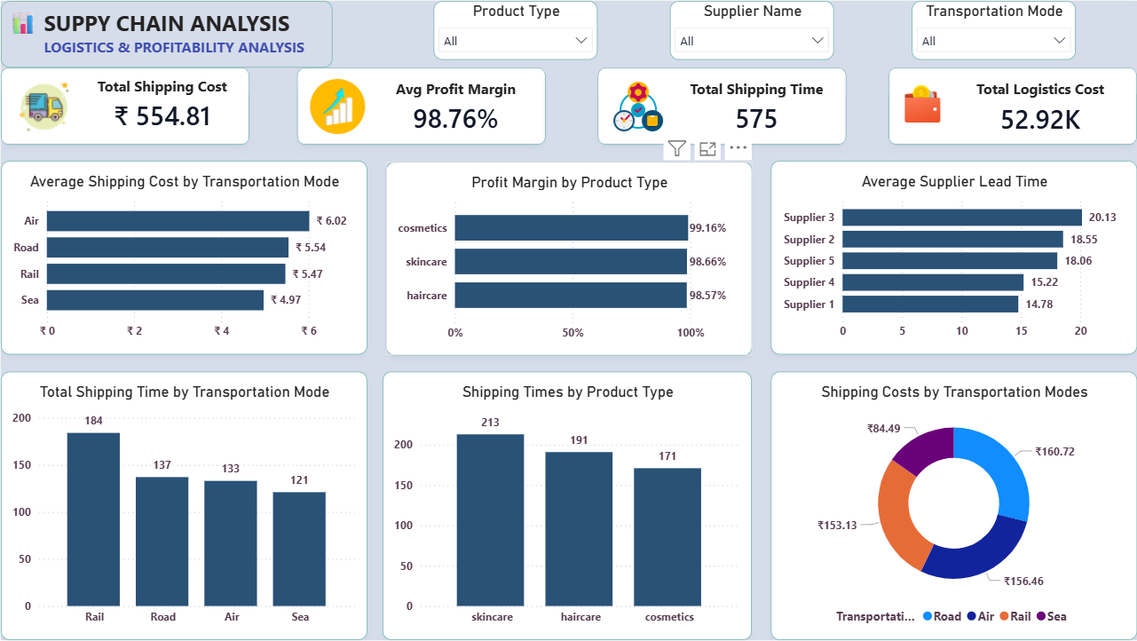
DASHBOARD PAGE 3
Logistics & Profitability Analysis
Live Power BI dashboard — shipping cost, time and margin analysis
12

Slide 13
Logistics & Profitability — Key Insights
Avg. Shipping Cost by Transport Mode
Key Insights
Air freight is the costliest mode (₹6.02/unit); Sea is the most economical (₹4.97/unit).
Cosmetics delivers the highest profit margin (99.16%), just ahead of skincare and haircare.
Supplier 3 has the longest average lead time (20.13 days) — a potential bottleneck.
Avg. Profit Margin by Product Type
Supplier 1 offers the shortest lead time (14.78 days), supporting faster replenishment.
Skincare products have the longest average shipping time among the three categories.
Total logistics cost across the business is ₹52.92K, with an overall 98.76% profit margin.
Supply Chain Analysis — Power BI Project
13

Slide 14
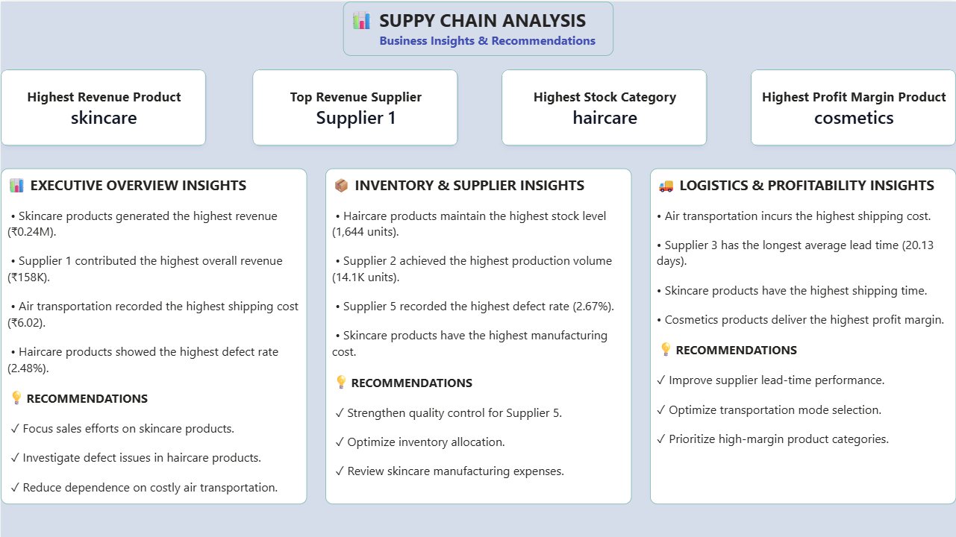
DASHBOARD PAGE 4
Business Insights & Recommendations
Live Power BI dashboard — consolidated takeaways by area
14

Slide 15
Consolidated Key Findings
The headline takeaway from each dashboard page
Highest Revenue Product
Top Revenue Supplier
Highest Stock Category
🏆
🤝
📦
Skincare
Supplier 1
Haircare
Highest Profit Margin
Costliest Transport Mode
Longest Supplier Lead Time
💰
✈️
⏳
Cosmetics
Air (₹6.02/unit)
Supplier 3 (20.13 days)
Bottom line: skincare and Supplier 1 drive the business, but haircare quality, Air freight cost and Supplier 3's lead time are the clearest areas for improvement.
Supply Chain Analysis — Power BI Project
15

Slide 16
Strategic Recommendations
Sales & Marketing
Quality Control
Focus promotional spend on skincare — the strongest revenue driver.
Investigate demand drivers behind Supplier 1's revenue leadership.
Strengthen inspection and QC protocols for Supplier 5 (highest defect rate).
Investigate root causes of defects in haircare production specifically.
Inventory Management
Logistics & Profitability
Review haircare stock allocation to avoid overstocking vs. demand.
Re-evaluate skincare manufacturing costs to protect margins.
Shift more volume to Sea/Rail where transit time allows, to cut cost.
Work with Supplier 3 to shorten lead time or diversify sourcing.
Prioritise and promote high-margin categories like cosmetics.
Supply Chain Analysis — Power BI Project
16

Slide 17
Challenges & Limitations
!
Small sample size
!
No customer-level detail
The dataset contains 100 SKU-level records, limiting statistical depth.
Beyond broad demographics, individual customer behaviour isn't captured.
!
No time dimension
!
Limited geographic depth
Data is a single snapshot — seasonality and trends can't be analysed.
Supplier locations are recorded but regional cost drivers aren't broken out.
!
Simulated figures
!
Static Power BI file
Cost, margin and defect values appear synthetic rather than audited financials.
The dashboard is not connected to a live/refreshing data source.
Supply Chain Analysis — Power BI Project
17

Slide 18
Conclusion & Future Scope
Conclusion
Future Scope
This Power BI dashboard turns raw supply chain data into a clear, interactive story — showing that skincare and Supplier 1 lead performance, while haircare quality and Air freight costs are the key levers for improvement.
By combining revenue, inventory, supplier and logistics metrics on one screen, the project demonstrates how business intelligence can shorten the path from raw data to actionable decisions.
Connect the dashboard to a live/refreshing data source for real-time monitoring.
Apply predictive analytics (e.g. demand or defect forecasting) using Power BI + AI visuals.
Expand the dataset with a longer time period to analyse seasonal trends.
Add drill-through pages for SKU-level and route-level deep dives.
Incorporate customer feedback data to link satisfaction with supply chain performance.
Supply Chain Analysis — Power BI Project
18

Slide 19
Thank You
Questions & Discussion
Abhiyuday Sharma| Bhaveen Kumar Tak | Mittal School of Business, LPU

